Slide 1
Pop Art
Once you “got” Pop, you could never see a sign the same way again. And once you thought Pop, you could never see America the same way again.
--Andy Warhol
Notes:
‹#›

Slide 3
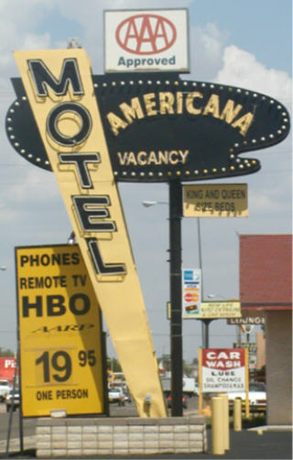
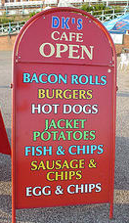
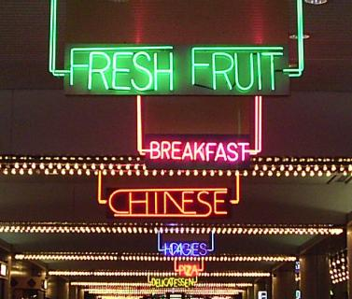
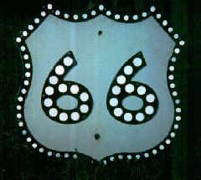
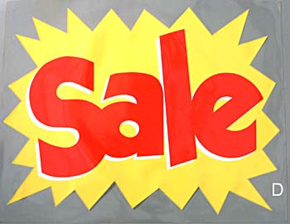
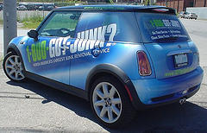
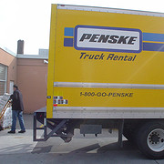
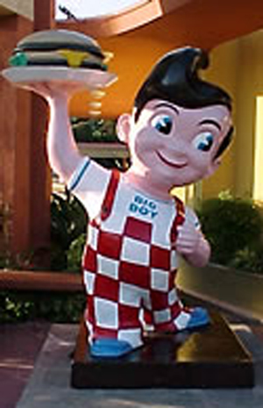
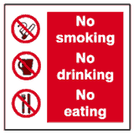
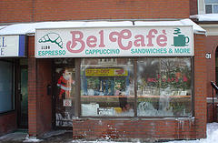

Slide 4
Pop Art
Pop Art was an art movement in the late 1950s and 1960s that reflected everyday life and common objects. Pop artists blurred the line between fine art and commercial art.
Brillo Soap Pads Box, 1964, © AWF

Slide 5
“Pop Artists created images that anybody walking down the street could recognize in a split second…all the great modern things that the Abstract Expressionists tried so hard not to notice at all.”—Gretchen Berg.
Three Coke Bottles, 1962, © AWF

Slide 6
The Pop artists moved away from Abstract Expressionism which was the “in” style of art in the 50s. The Abstract Expressionist evoked emotions, feelings and ideas through formal elements such as:
Line
Color
Shape
Form
Texture
Jackson Pollock, Number 4, 1950
Carnegie Museum of Art;
Gift of Frank R. S. Kaplan/©ARS

Slide 7
Pop Artists used common images from
everyday culture as their sources including:
Advertisements
Consumer goods
Celebrities
Photographs
Comic strips
Roy Lichtenstein, Masterpiece, 1962

Slide 8
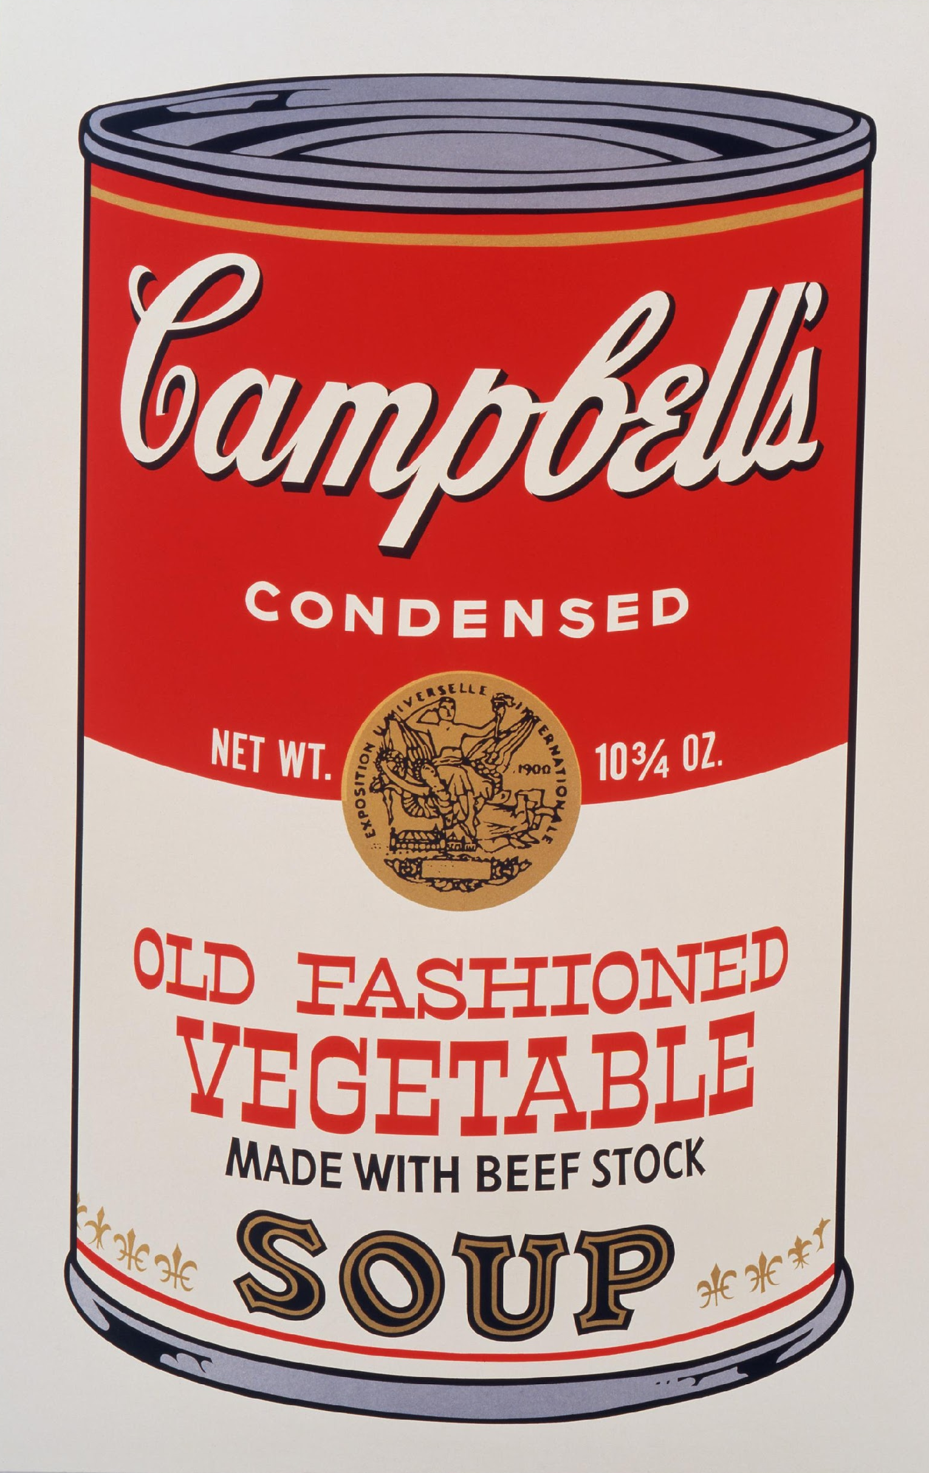
Pop Artists used bold, flat colors and hard edge compositions adopted from commercial designs like those found in:
Billboards
Murals
Magazines
Newspapers
Campbell's Soup II, 1969, © AWF

Slide 9
Pop Artists reflected 60’s culture by using new materials in their artworks including:
Acrylic Paints
Plastics
Photographs
Fluorescent and
Metallic colors
Robert Rauschenberg, Retroactive II, 1963

Slide 10
As well as new technologies and methods:
Mass production
Fabrication
Photography
Printing
Serials
Claes Oldenburg, Floor Burger 1962, © Claes Oldenburg

Slide 11
Pop art was appealing to many viewers, while others felt it made fun of common people and their lives. It was hard for some people to understand why Pop Artists were painting cheap, everyday objects, when the function of art historically was to uphold and represent culture’s most valuable ideals.
Listerine Bottle, 1963, © AWF

Slide 12
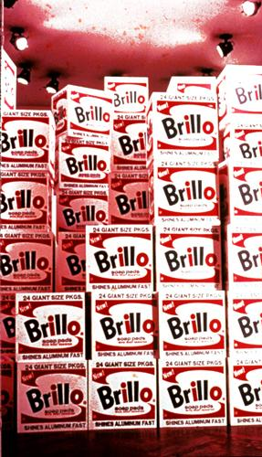
Andy Warhol was one of the most famous Pop Artists. Part of his artistic practice was using new technologies and new ways of making art including:
Photographic Silk-Screening
Repetition
Mass production
Collaboration
Media events
Andy Warhol, Brillo Boxes installation,

Slide 13
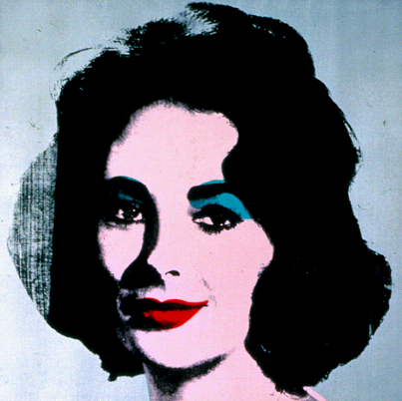
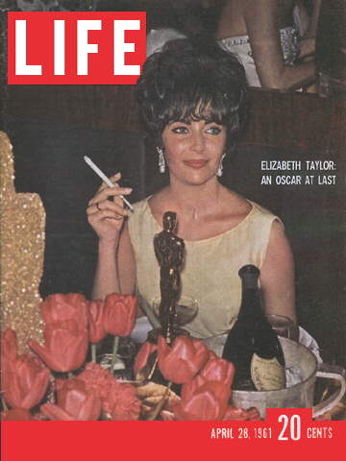
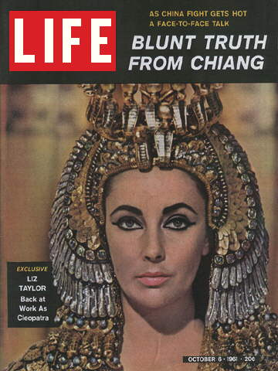
Warhol appropriated (used without permission) images from magazines, newspapers, and press photos of the most popular people of his time
©2006 Life Inc.
Silver Liz [Ferus Type], 1963, © AWF

Slide 14
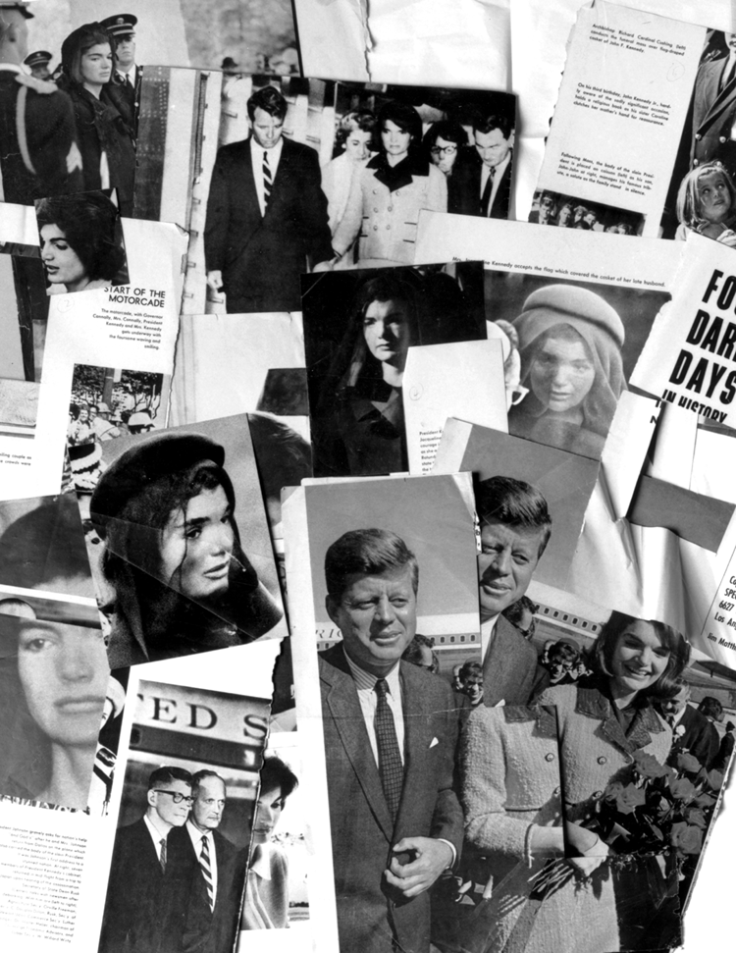
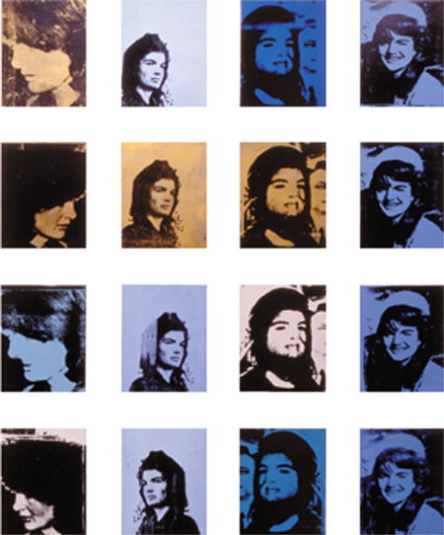
Warhol used the repetition of media events to critique and reframe cultural ideas through his art
Jackie paintings, 1964, © AWF

Slide 15
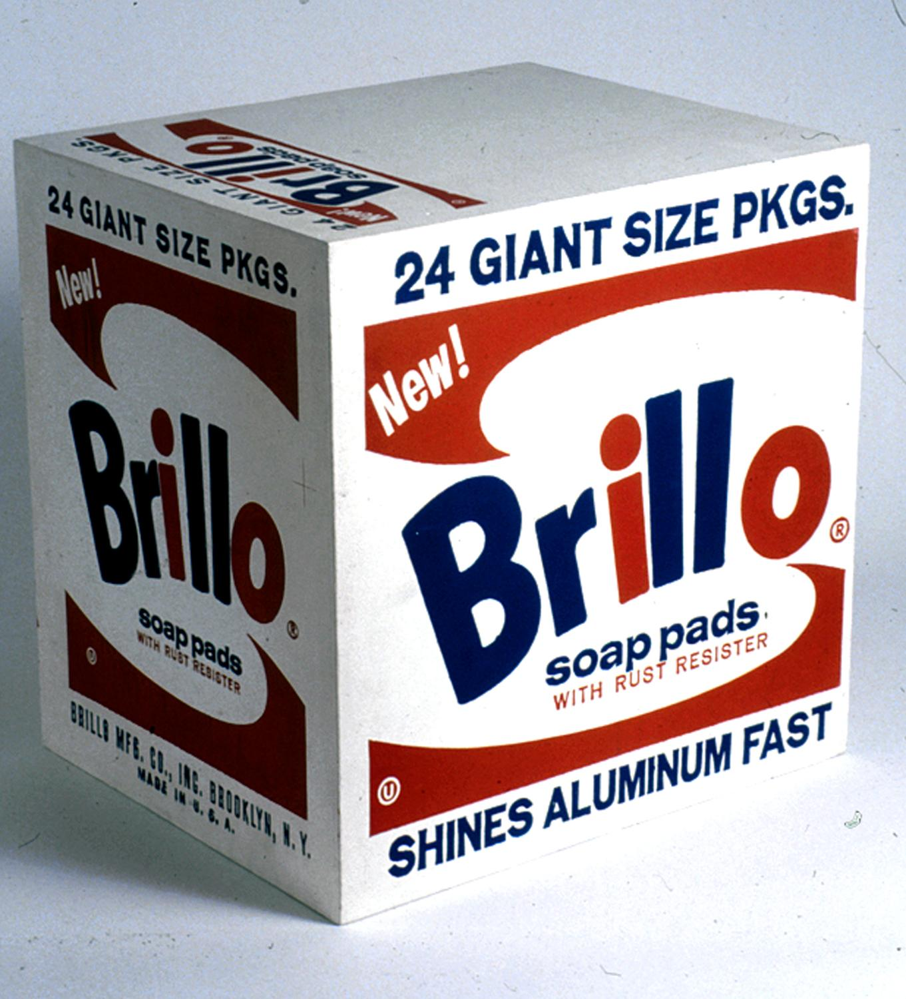
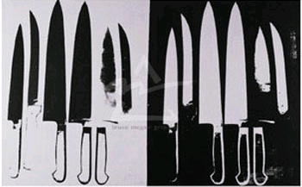
Warhol took common everyday items and gave them importance as “art” He raised questions about the nature of art:
Knives, 1981, © AWF
Brillo Soap Pads Box, 1964, © AWF
What makes one work of art better than another?

Slide 16
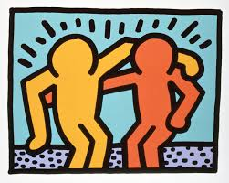
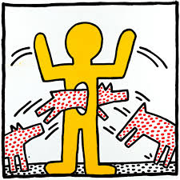
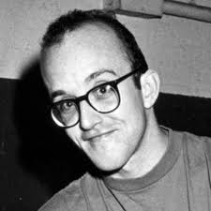
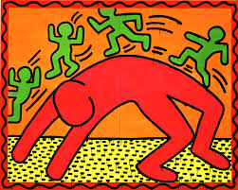
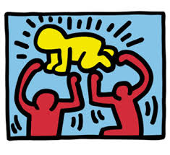
Keith Haring was another famous Pop Artists. He was an American artist and social activist whose work related to New York street culture.
heavily political work
concepts of birth, death, and
war
social activist
street culture

Slide 18
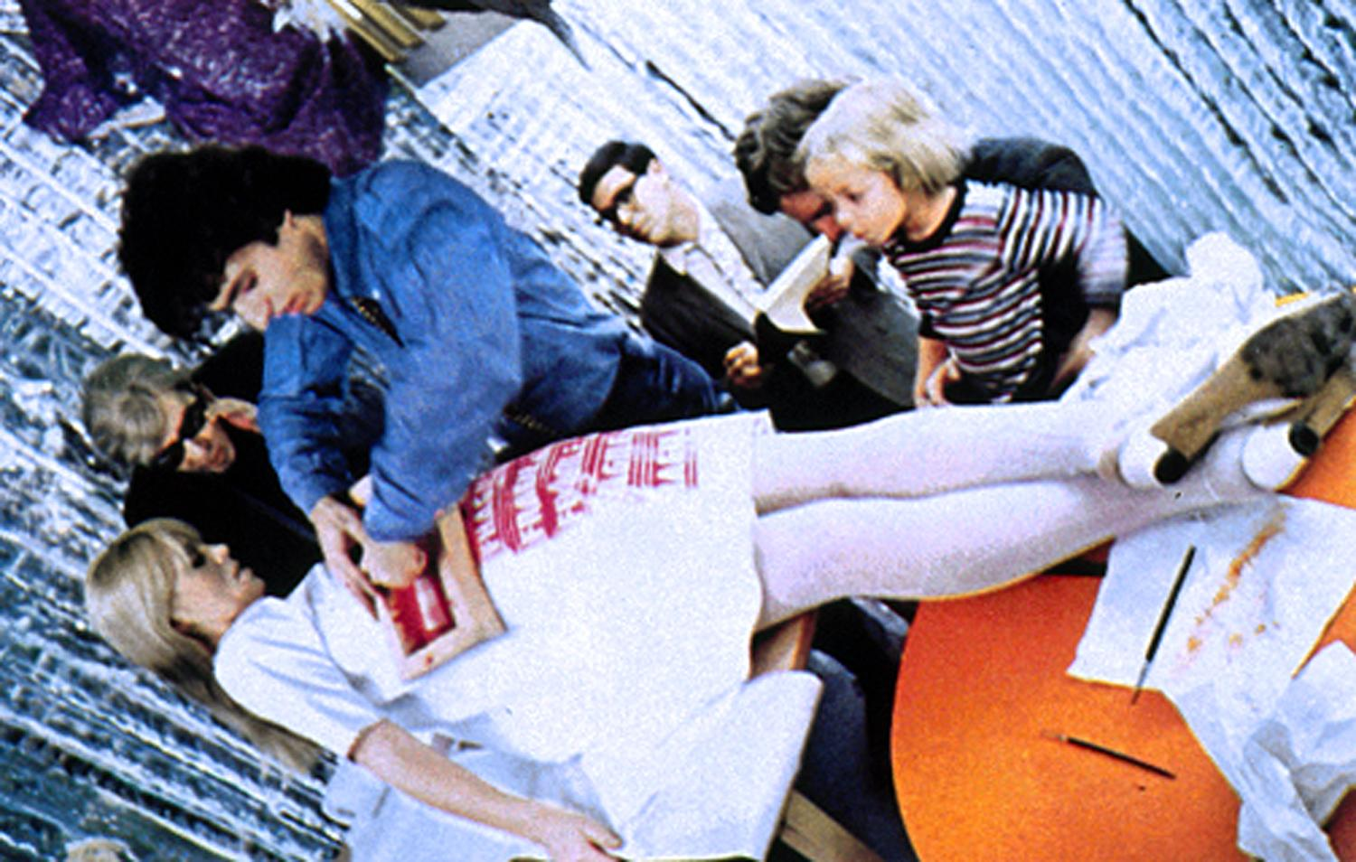
Pop artists stretched the definitions of what art could be and how it can be made.
photo by Hervé Gloaguen
“The Pop idea, after all, was that anybody could do anything, so naturally we were all trying to do it all…” ---Andy Warhol

Slide 19
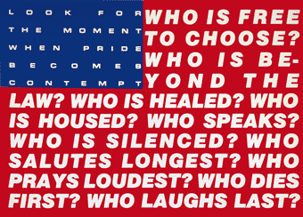
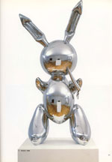
The art world today reflects many of the ideas, methods and materials initiated by the Pop Art movement.
In Untitled, 1991, Barbara Kruger uses the iconography of the American flag and hard edge graphics to pose a series of provocative questions about American cultural values.
Barbara Kruger, Untitled, 1991
Courtesy: Mary Boone Gallery, NY
In Rabbit, 1986, artist Jeff Koons cast a mass-produced inflatable Easter bunny in highly polished stainless steel. The sculpture became iconic of art in the 1980s.
Jeff Koons, Rabbit, 1986, © Jeff Koons
Link to Video

