Slide 1
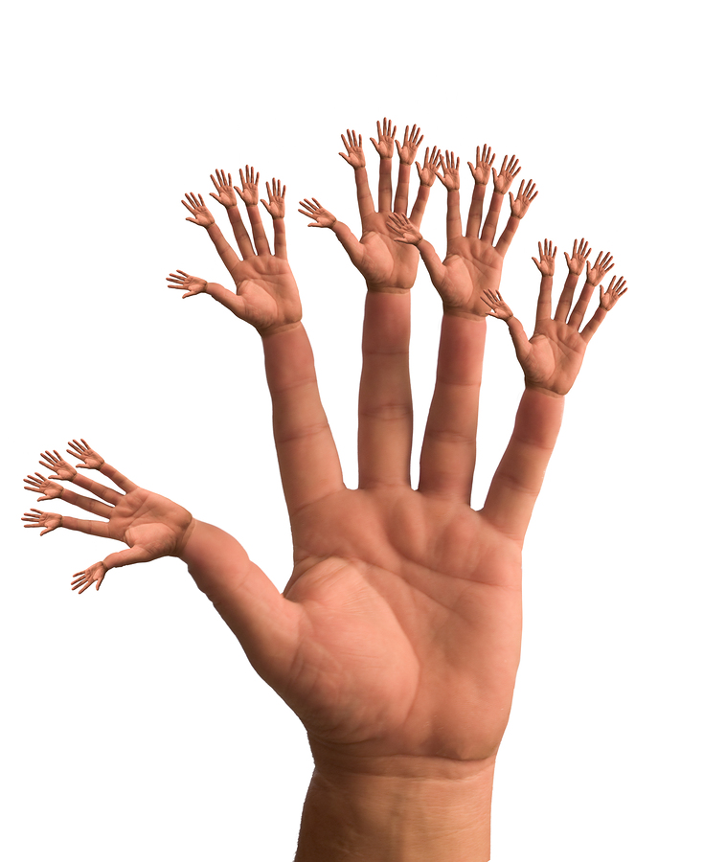
A.P. 2-D
Hands be Still

Slide 2
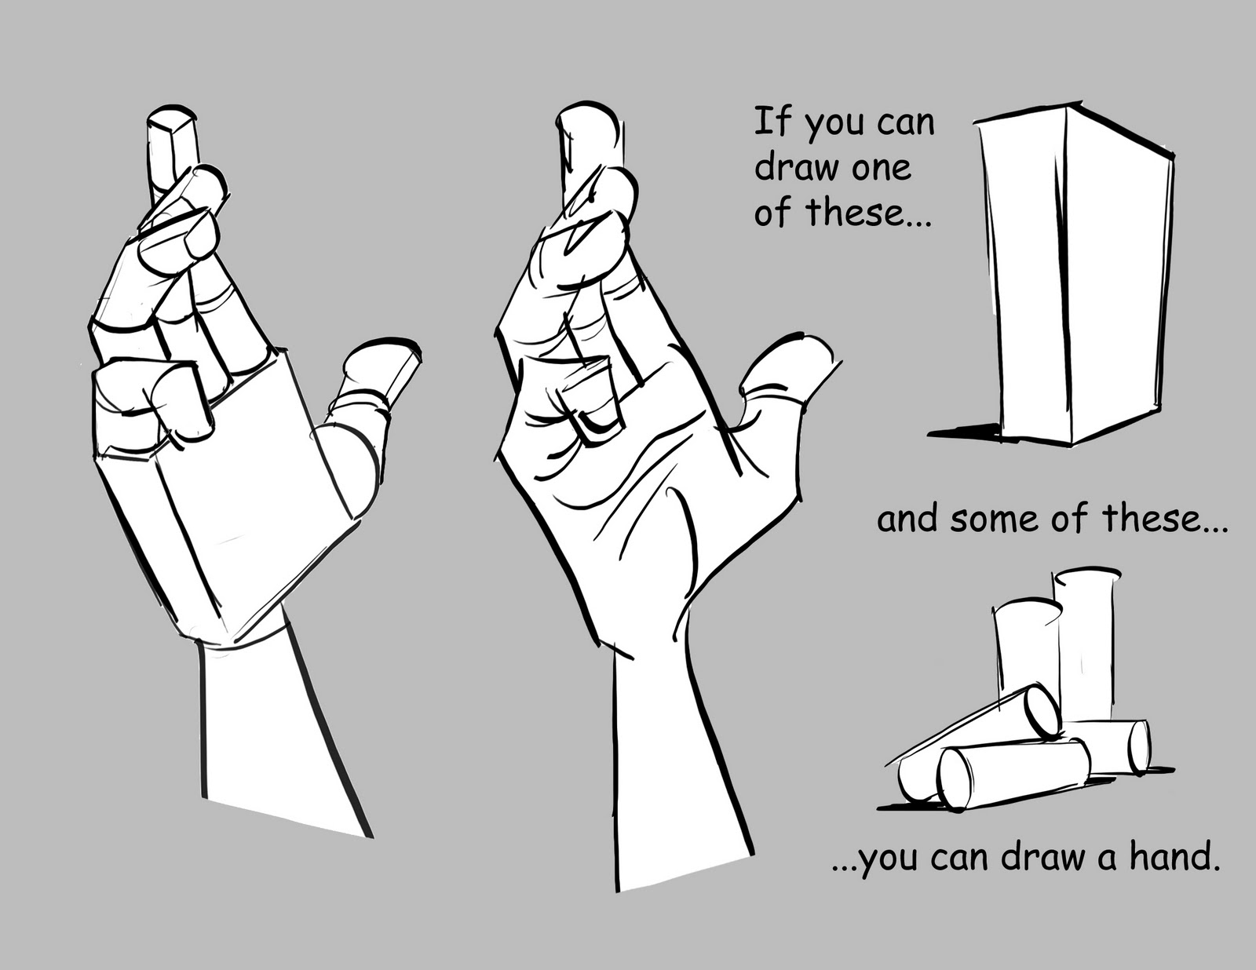

Slide 3
For this project you will be focusing on your hands. It is a study of observational drawing. You may use pencil, charcoal, pen & ink, conte crayon, pastels, collage, or graphite for this assignment and you should focus on line quality. Hands need to interact. Concept choice is up to you.

Slide 4
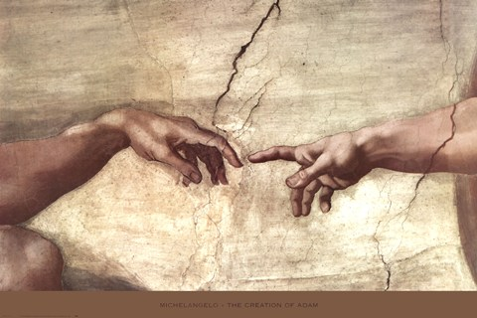
Hands
are expressive

Slide 5
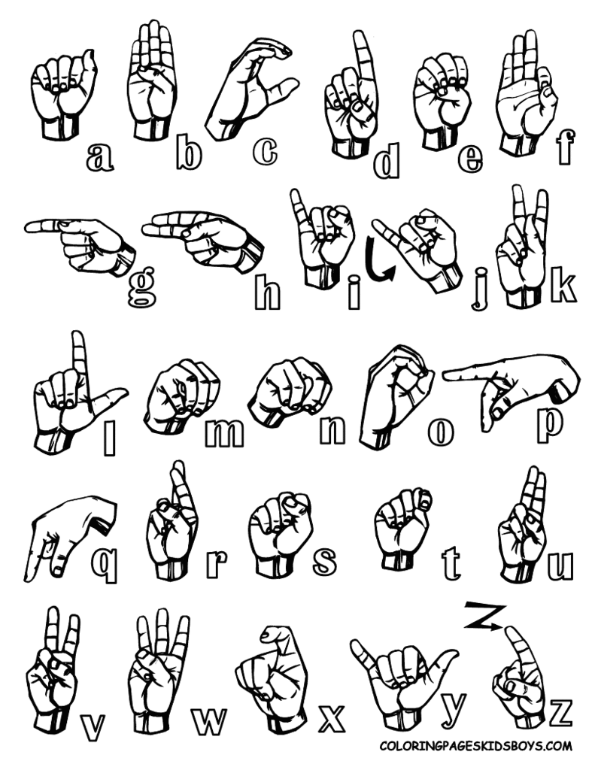
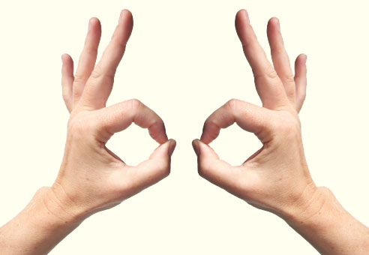
Think about gestures you can make with your hands, but keep them appropriate!

Slide 6
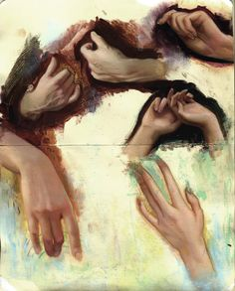
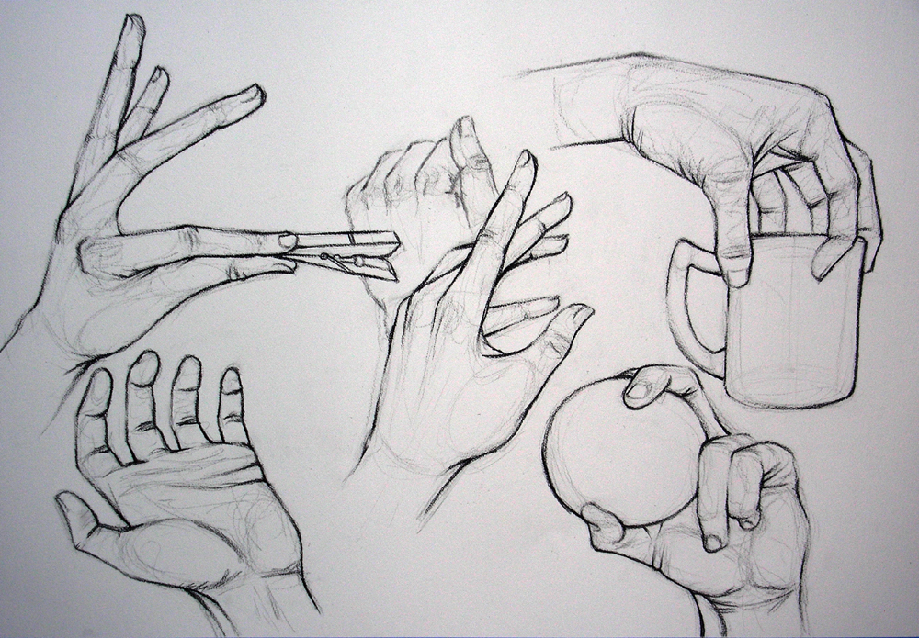
http://www.pinterest.com/artbabe3/ap-breadth-drawing-hands/

Slide 7
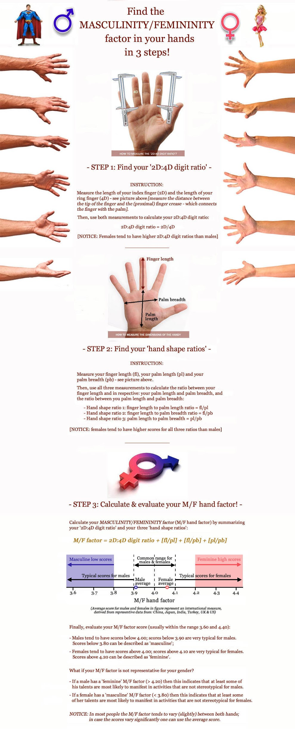
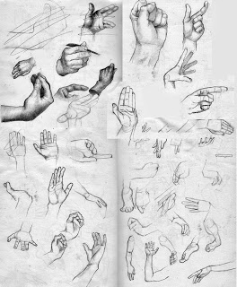

Slide 9
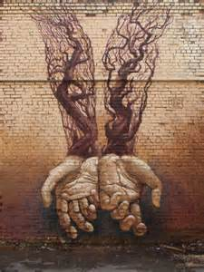
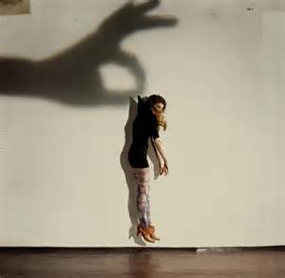

Slide 10
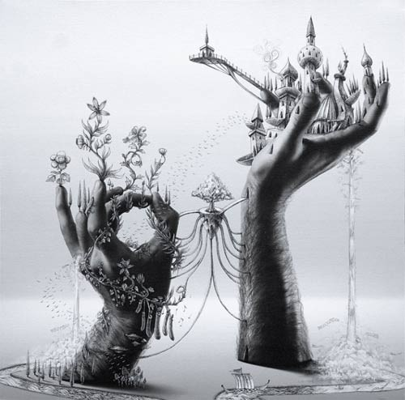

Slide 11
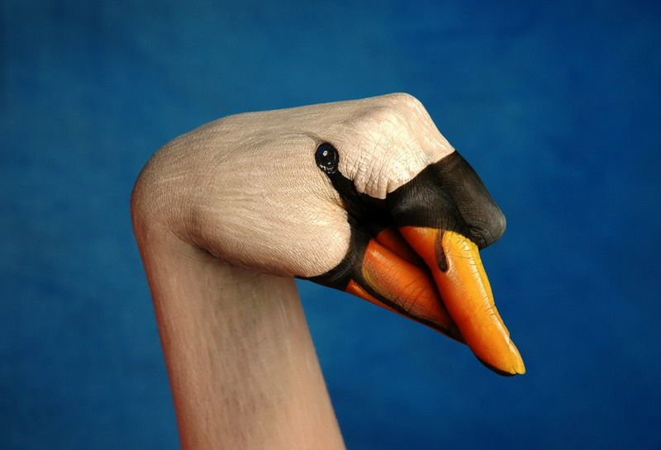

Slide 12
