Slide 1
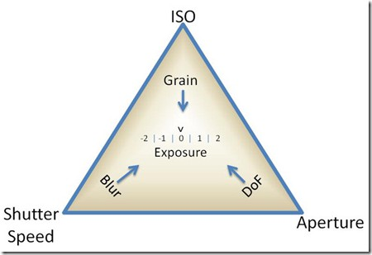
Shutter Speed
&
Aperture

Slide 2
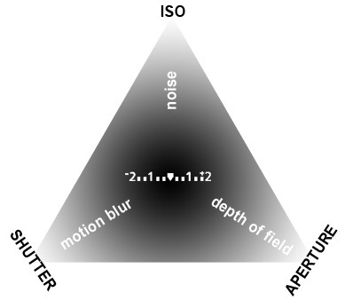
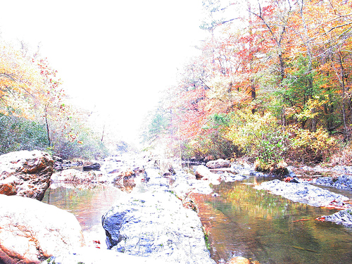
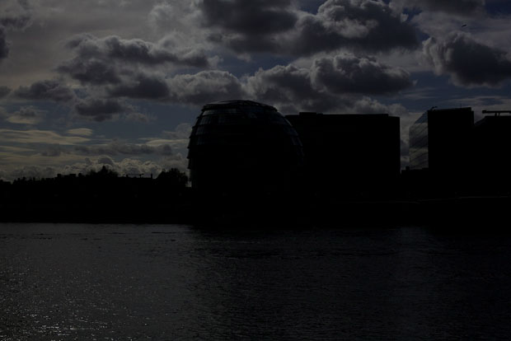
Exposure
The very beginning
Exposure Explained
Overexposure—too much light
Underexposure—not enough light

Slide 3
Exposure = Aperture + Shutter Speed
What is Exposure?
What affects Exposure?
How do they affect Exposure?
What happens when they are misaligned?
And ONE MORE VIDEO on exposure. (yeah!?)

Slide 4
ISO
ISO Explained
It is your film’s sensitivity
to light
100 ISO has the highest
quality
3200 ISO is appropriate for sports
100 or 200 ISO would need a tripod indoors

Slide 5
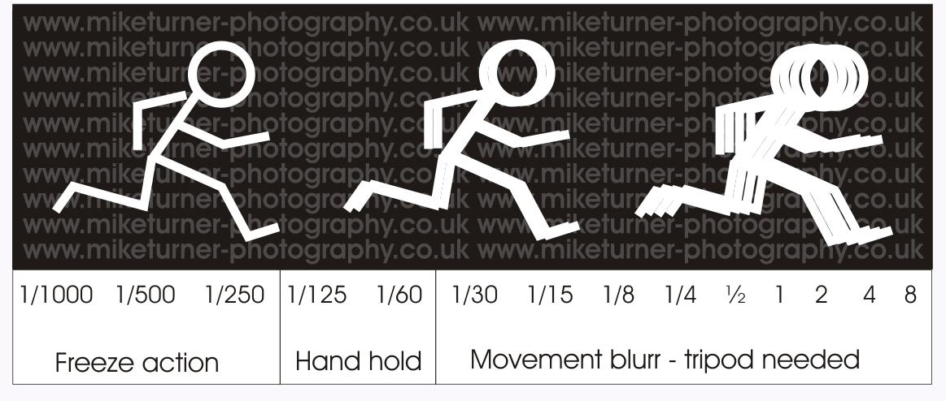
Shutter Speed
How long the shutter stays open to take the photograph.
How the shutter works….

Slide 6
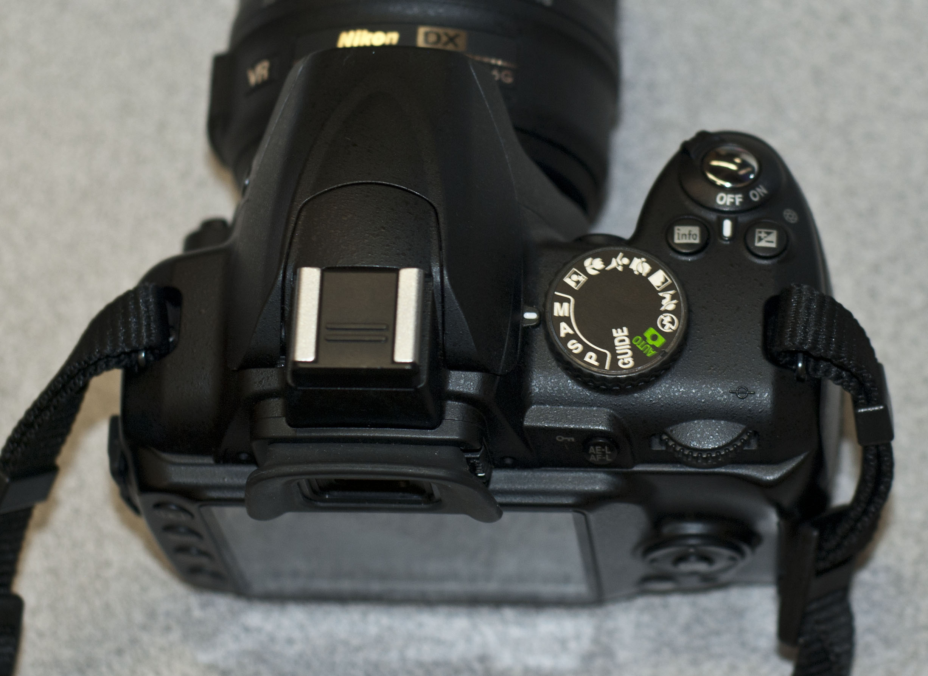
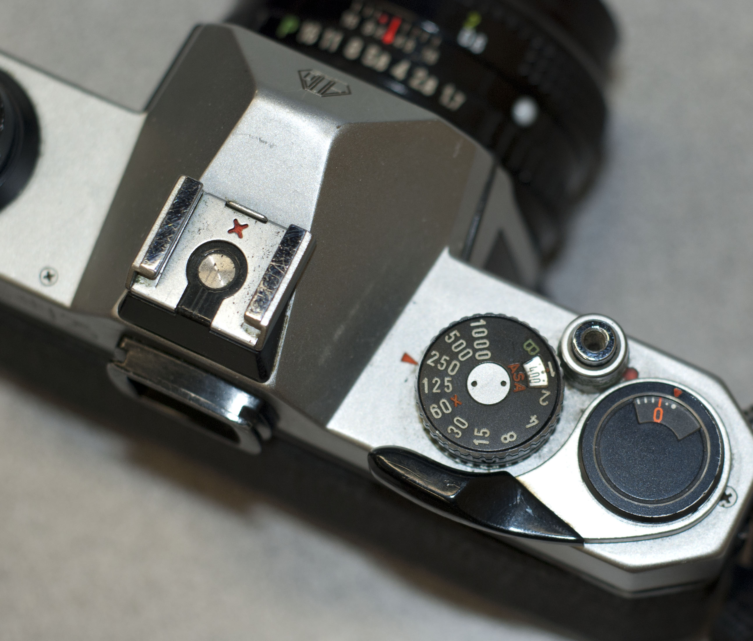
Shutter Speed on our cameras…
On a Manual SLR camera
The shutter is changed by spinning the dial
Speeds on this camera: 1/1000, 1/500, 1/250, 1/125, 60, 30, 15, 8, 4, 2, B
On a Digital SLR camera
On a Digital SLR (Nikon D3000)
Set the camera to Manual (M)
Spin the dial
Speeds on this camera: 30 sec-1/4000
Notes:
*mention point & shoot

Slide 7
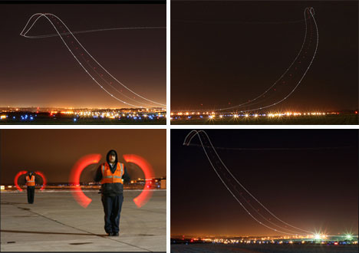
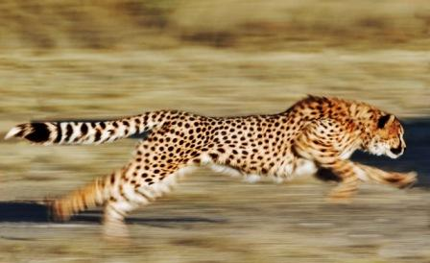
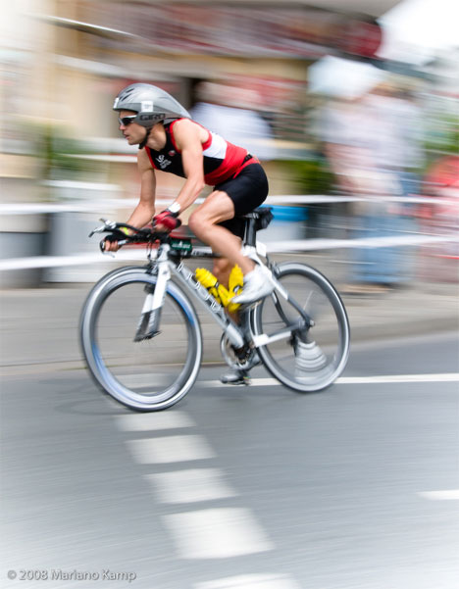
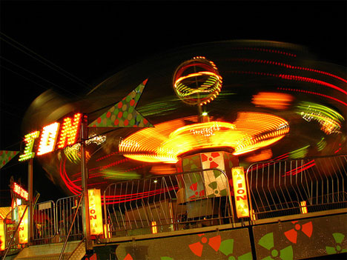
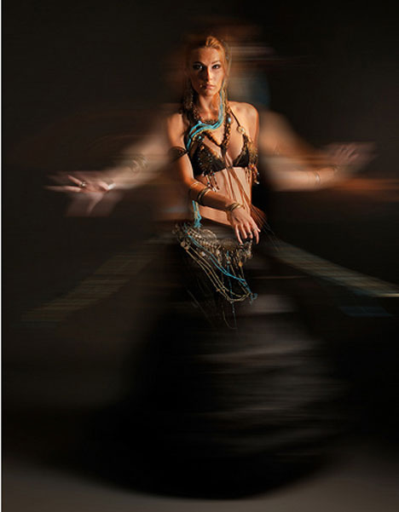
Slow Shutter Speed (1/30 or slower)

Slide 8
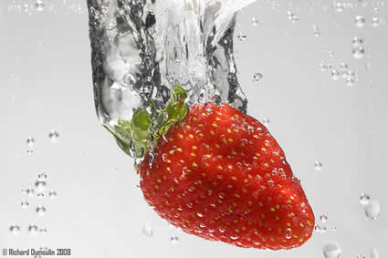
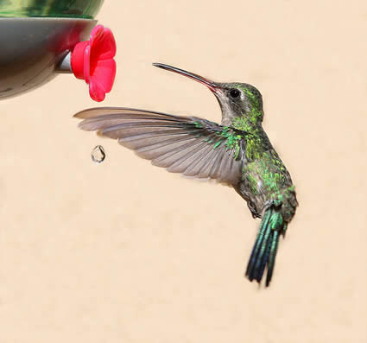
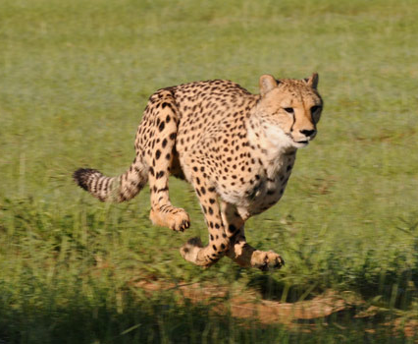
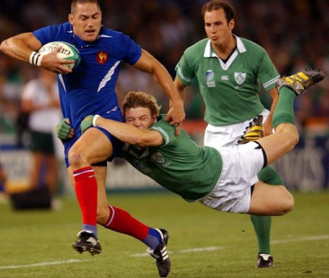
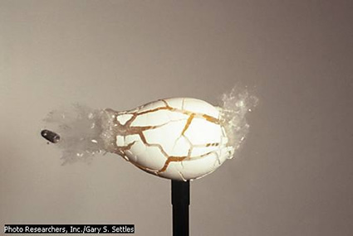
Using a Fast Shutter Speed (1/250 or higher)

Slide 9
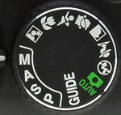
You can try to show or stop motion while your camera is an automatic mode…
Night Photo Option
to show motion
Sports Photo Option
to freeze motion

Slide 10
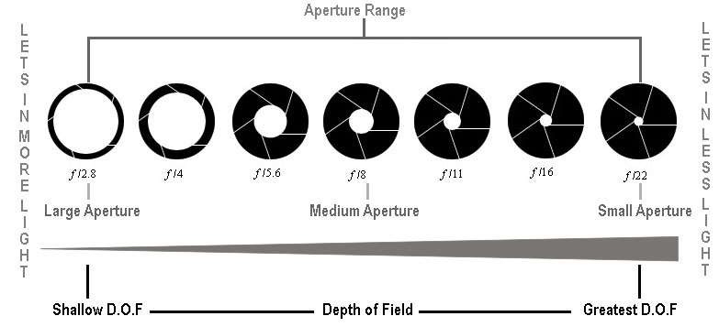
Aperture
Aperture is the opening through which light travels—the
size of the opening dictates the amount of light allowed in.

Slide 11
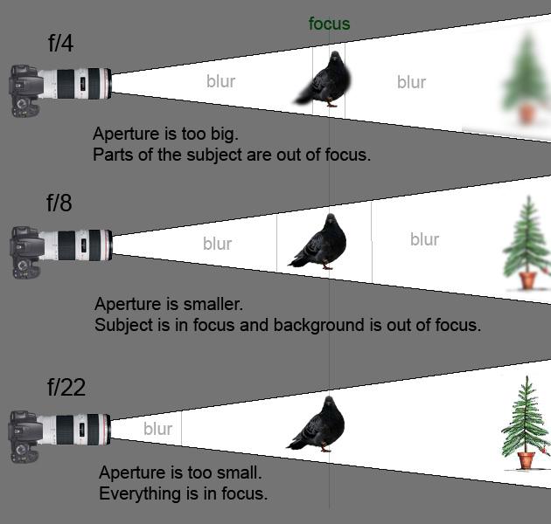
Watch these videos to further explore aperture and depth of field.
How the Aperture works…
Depth of Field Explained

Slide 12
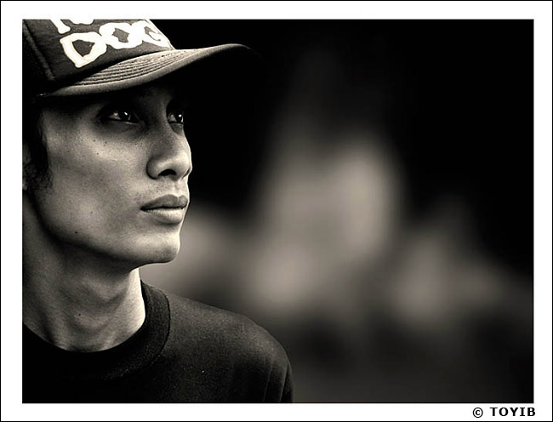
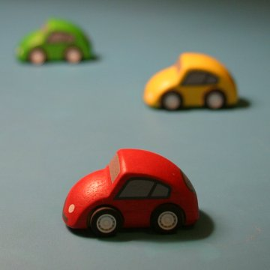
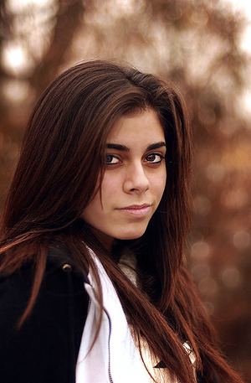
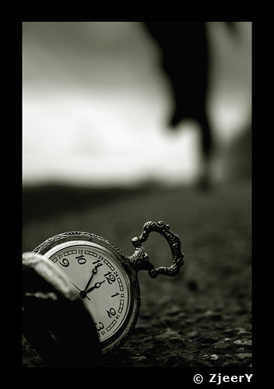
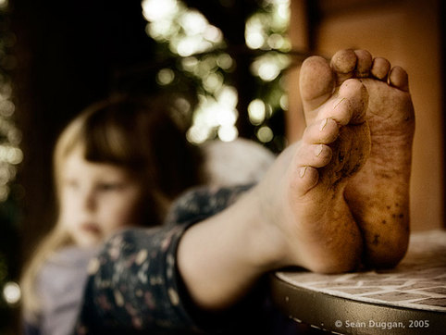
Large Aperture opening = Shallow Depth of Field
f1.8, f2, f2.8, f4, f5.6
*the smaller the number, the larger the opening*

Slide 13
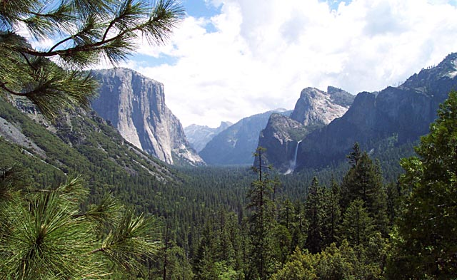
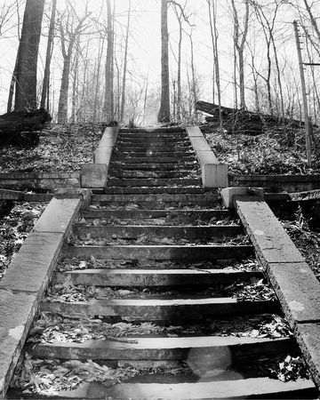
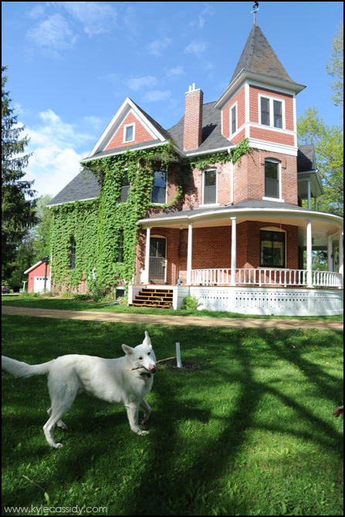
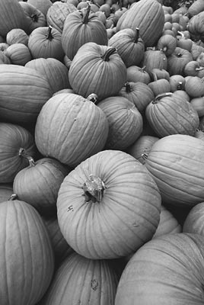
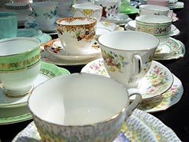
Small Aperture Opening = Large Depth of Field
f8, f11, f16, f22
*the larger the number, the smaller the opening*

Slide 14
Aperture on our cameras…
On a Manual SLR camera
The aperture is changed by turning the ring so that the Fstop lines up with the red-oragne line
Fstops: f1.7, f2.8, f4, f5.6, f8, f11, f16
On a Digital SLR camera
On a Digital SLR (Nikon D3000)
Set the camera to Manual (M)
Hold the exposure button & spin the dial
Fstops: f5, f5.6, f6.3, f7.1, f8, f9, f10, f11, f13, f14, f16, f18, f20
Notes:
*mention point & shoot

Slide 15
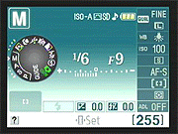
The Light Meter
Nikon D3000
This is the menu which shows on the screen. In the middle you see a graph from + to –.
Proper exposure is achieved when the small lines are exactly in the middle.
Far to the left creates an overexposed image. Far to the right creates an underexposed image.

Slide 16
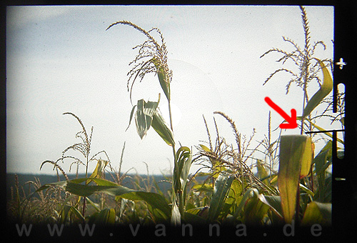
The Light Meter cont’d.
Our Pentax cameras have a wand that moves up and down as you change your settings. You want the wand to be in the middle and pointing straight out into the frame.

Slide 17
Now you try!
Follow the directions on the handout while using the Camera Simulator

